Slide 1
Under sampling and Over sampling (SMOTE) methods on Imbalance Ovarian cancer dataset
Instructor:
Behnoud Shafizadeh
7 June 2022

Slide 2
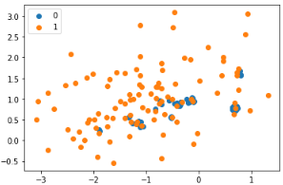
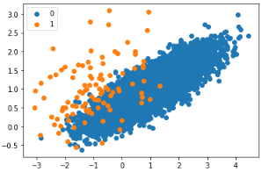
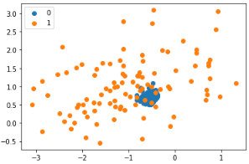
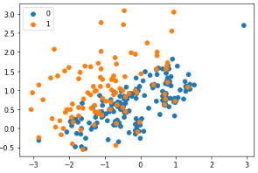
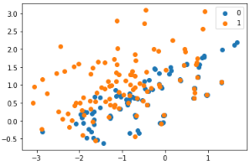
Undersampling Algorithms for Imbalanced Classification
A suite of techniques has been developed for undersampling the majority class that can be used in conjunction with effective oversampling methods. The simply random undersampling which randomly delete majority samples does not consider the information. It may destroy helpful information extracted by majority samples blindly. Thus, exploring other methods will be useful.
Different methods of Undersampling
NearMiss-1: keeping Majority class examples with minimum average distance to three closest minority class examples.
NearMiss-2: keeping Majority class examples with minimum average distance to three furthest minority class examples.
NearMiss-3: keeping Majority class examples with minimum distance to each minority class example.
{0: 100, 1: 100}
Condensed Nearest Neighbor
NearMiss-1
Focusing one those examples in the majority class along the decision boundary between the two classes, specifically, those majority examples can not be classified correctly by KNN classifier
{0: 9900, 1: 100}
{0: 100, 1: 100}
{0: 189, 1: 100}
NearMiss-2
{0: 100, 1: 100}
NearMiss-3
We have another methods you can see them in Jason Brownlee's book,….

Slide 3
Synthetic Minority Oversampling Technique(SMOTE) for imbalance classification
One approach to addressing imbalanced datasets is to oversample the minority class. The simplest approach involves duplicating examples in the minority class, although these examples don’t add any new information to the model, so the new approach called SMOTE has been introduced. This is called in 2002 as a paper ““SMOTE: Synthetic Minority Over-sampling Technique.”
What does SMOTE perform in details?
SMOTE first selects (a) minority class instance a at random and finds its k nearest (typically k=5) minority class neighbors. The synthetic instance is then created by choosing one of the k nearest neighbors (b) at random and connecting (a) and (b) to form a line segment in the feature space. The synthetic instances are generated as a convex combination of the two chosen instances (a) and (b).
Notice : The combination of SMOTE and under-sampling performs better than plain under-sampling.
Effectiveness of SMOTE method
- The combination of SMOTE and under-sampling performs better than plain under-sampling. are relatively close in feature space to existing examples from the minority class.
Synthetic over-sampling works to cause the classifier to build larger decision regions that contain nearby minority class points.
It has a better performance compared to simply replicating upsampling method which does not add any useful information to training dataset.
Weaknesses of SMOTE method
A general downside of the approach is that synthetic examples are created without considering the majority class, possibly resulting in ambiguous examples if there is a strong overlap for the classes.
As a result,…
- I have achieved higher ROC AUC (0.830) using SMOTE than when using Decision Tree classifier solely with ROC AUC (0.759). Moreover, combination of (SMOTE and undersampling) has the greatest amount of ROC AUC standing at (0.840).
- Different values of k affects the values of ROC AUC. For instance, K=6 is selected as a candidated value.

Slide 4
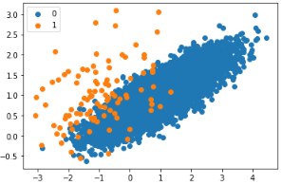
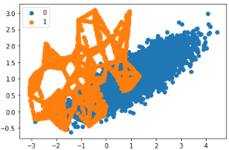
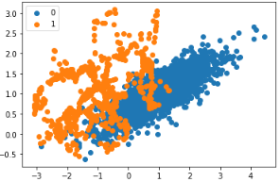
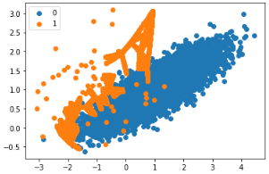
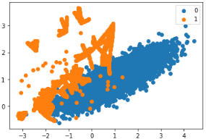
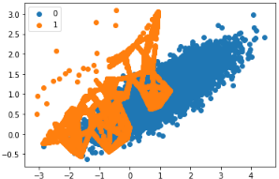
Example of different SMOTE methods
{0: 9900, 1: 100}
{0: 9900, 1: 9900}
{0: 1980, 1: 990}
Original dataset with minority in class 1 and majority in class 0
More examples in the minority class created along the lines between the original examples in the minority class.
Oversample with SMOTE and random undersample
for imbalanced dataset
{0: 9900, 1: 9900}
{0: 9900, 1: 9900}
{0: 9900, 1: 9899}
borderline-SMOTE for imbalanced dataset
borderline-SMOTE with SVM for
imbalanced dataset
Oversample and plot imbalanced
dataset with ADASYN

Slide 5
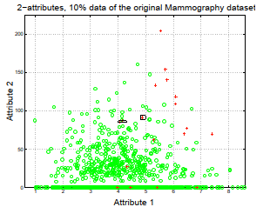
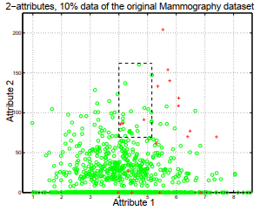
Summarization of paper related to : “SMOTE: Synthetic Minority Over-sampling Technique”
Overview of literature review
under-sampling the majority class enables better classiﬁers to be built than over-sampling the minority class.
A combination of the two method does not lead to classiﬁers that outperform those built utilizing only undersampling.
Oversampling of the minority class has been done by sampling with replacement from the original data.
Methodology of SMOTE
We propose an over-sampling approach in which the minority class is over-sampled by creating “synthetic” examples rather than by over-sampling with replacement, which causes a random point along the line segment between two speciﬁc features.
Effects of SMOTE method in Decision Tree (or KNN,…) classification method
Creating larger and less speciﬁc decision regions rather than smaller and more speciﬁc regions. More general regions are now learned for the minority class samples rather than those being subsumed by the majority class samples around them.
Before SMOTE
After SMOTE

Slide 6
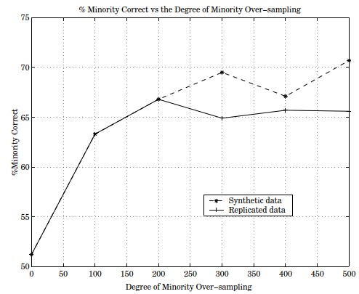
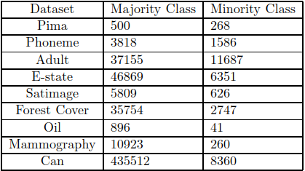
Summarization of paper related to : “SMOTE: Synthetic Minority Over-sampling Technique”
The SMOTE has a better Minority classification than replicated over-sampling
Furthermore, combining under-sampling and over-sampling, the initial bias of the learner towards the negative (majority) class is reversed in the favor of the positive (minority) class.
Experimental results
Finally results:
- Different algorithms with/without SMOTE not such as :
Ripper
Naïve Bayes Classifier
C4.5
10-fold cross-validation
5 nearest neighbors (k=5)
9 different datasets such as :
Improve the accuracy of classiﬁers for a minority class
Larger decision regions and more specific towards other methods
SMOTE-classiﬁer (C4.5,Ripper, Naïve Bayes) has more potentially optimal classiﬁers than any other approaches.

Slide 7
Summarization of paper related to : “The harm of class imbalance corrections for risk prediction models: illustration and simulation using logistic regression ”
Subject: Classifying people involving with ovarian cancer in terms of two classes : “high risk” and “low risk” groups
Target : examining the effect of imbalance dataset on ridge logistic regression in terms of discrimination (ROC AUC), calibration (probability to belong to the minority class), and classification (Sensitivity and Specificity) accompanying by imbalance correction methods such as random undersampling, random oversampling and SMOTE
Dataset : ovarian cancer diagnosis
Features :
age of the patient (years)
maximum diameter of the lesion (mm)
number of papillary structures ( values 0 to 4)
Size :
Training (80%) (518 class:1, 2177 class 0)
Testing (20%) (507 class 0, 140 class 1)
Results or challenges:
Accuracy is not a good measure as a high percentage is achieved (majority class having close to 100 percent accuracy and the minority class having accuracies of 0-10 percent, )
Adjustment of the classification threshold probability will be considered correctly (by using ROC chart)
poor calibration (strong overestimation of the probability to belong to the minority class). In fact, the imbalance correction methods distort model calibration by leading to probability estimates that are too high (or overtreatment). Many individuals would exceed a given probability threshold and would be selected for treatment
Not improving in ROC AUC metric (discrimination)
Leading improvement in Sensitivity and Specificity (classification)
Noticing that moving probability threshold also has a similar results such as imbalance correction methods
The imbalance correction method does not guarantee that result will be better

Slide 8

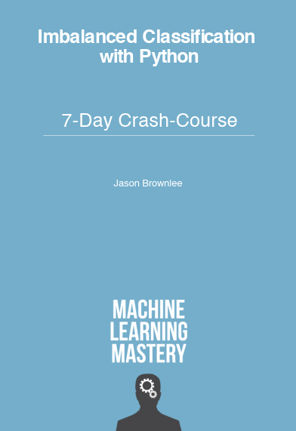
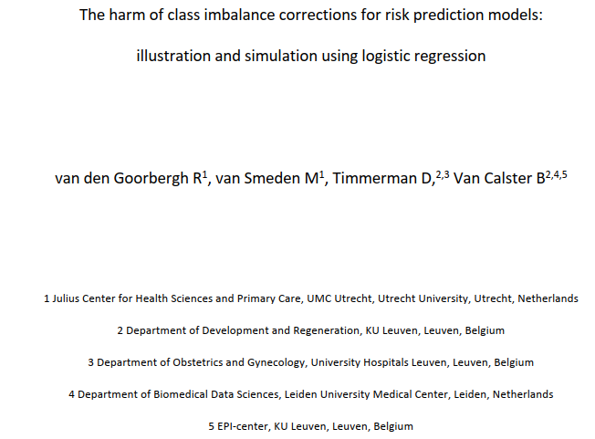
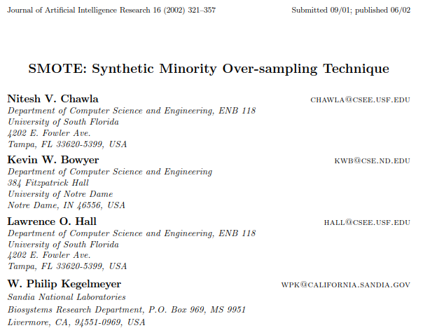
References
Jason Brownlee
https://machinelearningmastery.com/category/imbalanced-classification/
Articles

Slide 9
Thanks for your consideration.

